Slide 1
REMOTE CONSIDERATIONS:
ETHICAL CONCERNS BEYOND THE PANDEMIC August 25, 2021

Slide 2
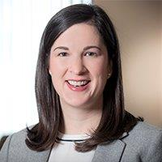
presenters
Megan Sterchi Lammert
Baker Sterchi Cowden & Rice LLC
Kansas City, MO, USA E: msterchi@bscr-law.com
T: 816-471-2121
Christin Krämer
Tiefenbacher
Heidelberg, Baden-Württemberg, Germany
E: kraemer@tiefenbacher.de
T: +49 6221 3113-20
Kate Q. Martz
Baylor Evnen, LLP
Lincoln, NE, USA E: kmartz@baylorevnen.com
T: 402-475-1075
Emily Motto Bottorf
Baylor Evnen, LLP
Lincoln, NE, USA E: emotto@baylorevnen.com
T: 402-475-1075

Slide 3
The Pandemic Effect
on the workforce

Slide 4
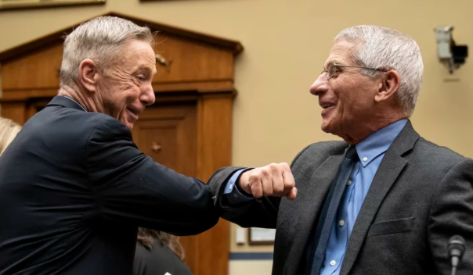
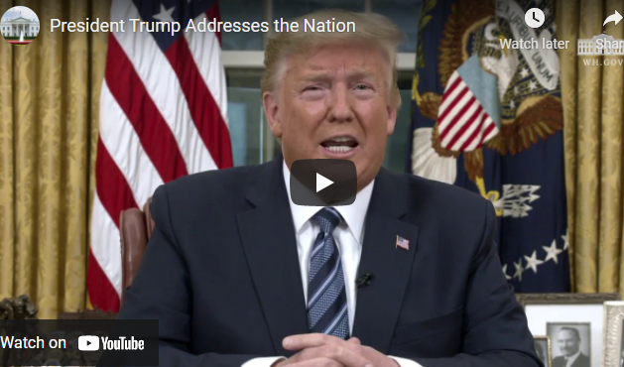
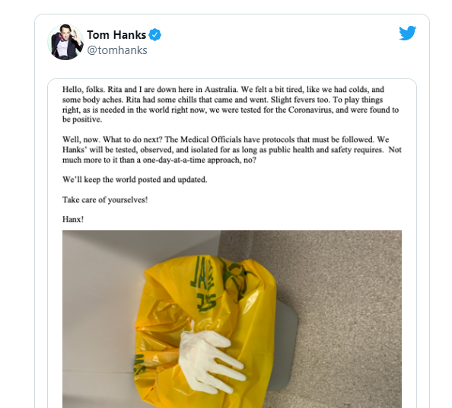
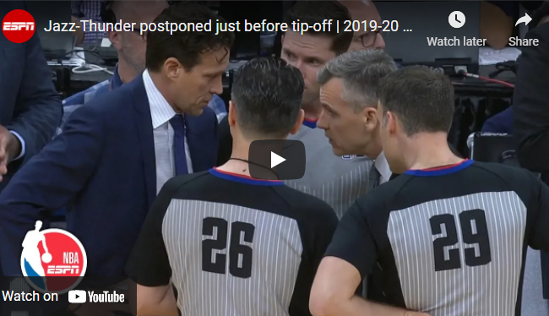
How we got here
March 11, 2020 (“The Day”)

Slide 5
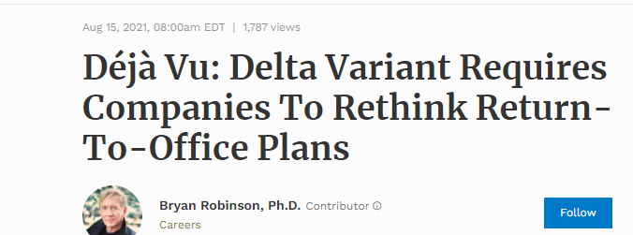
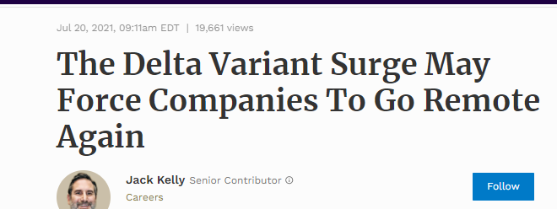
How we got here PART II

Slide 6
Employment satisfaction with remote work
Mixed results with trends towards remote work
Productivity
Job Satisfaction
Motivation
Employers expect increased number of employees will be working remotely by the end of 2021

Slide 7
polls

Slide 8
Ethical Considerations

Slide 10
ABA Formal opinion 498
ABA Model Rules of Professional Conduct permit a virtual law practice
“Virtual Practice” - A technologically enabled law practice beyond the traditional brick-and-mortar law firm.
Today, discussing ABA Model Rules of Professional Conduct surrounding:
Competence - Rule 1.1
Diligence - Rule 1.3
Communication - Rule 1.4
Confidentiality - Rule 1.6
Supervision - Rules 5.1 and 5.3

Slide 11
German perspective
Main Obligations:
The German Federal Lawyer’s Act (Bundesrechtsanwaltsordnung)
Accompanied by
Rules of Professional Practice (Berufsordnung für Rechtsanwälte)
GDPR
German Criminal law
Similar Focus as ABA Model Rules of Professional Conduct

Slide 13
Competence

Slide 14
COMPETENCE - Aba Model Rule 1.1
A lawyer shall provide competent representation to a client. Competent representation requires the legal knowledge, skill, thoroughness and preparation reasonably necessary for the representation.

Slide 15
COMPETENCE - ETHICAL CONSIDERATIONS
Pennsylvania - Formal Opinion 2020-300 - Ethical Obligations for Lawyers Working Remotely
Competent representation includes obligation to understand risks and benefits of technology.
Comment [8] to Rule 1.1 - To maintain the requisite knowledge and skill, a lawyer should keep abreast of changes in the law and its practice, including the benefits and risks associated with relevant technology, engage in continuing study and education and comply with all continuing legal education requirements to which the lawyer is subject….
Duty of technological competence requires attorneys to:
Understand the risks and benefits of technology as it relates to the specifics of their practices, such as electronic discovery.
Understand the general risks and benefits of technology, including the electronic transmission of confidential and sensitive data, and cybersecurity, and to take reasonable precautions to comply with this duty.

Slide 16
German perspective
No specific laws for working remotely
SEC 43 German Federal Lawyer’s Act as general clause:
The attorney shall exercise his profession competent. The attorney shall prove himself worthy, both within and outside the profession, of the respect and trust which the position of lawyer requires.
SEC 2 Rules of Professional Practice:
Attorney need the organizational and technical measures that are necessary to protect confidentiality and are risk adequate and reasonable for the profession of lawyer. Technical measures are sufficient when they satisfy the requirements of data protection law in cases where the latter is applicable

Slide 17
PRACTICAL CONSIDERATIONS
KNOWLEDGE: Basic technical competence is required
What does this entail?
Devices
Software
Protection
Security

Slide 18
Practical considerations
Other areas of competence:
Law and procedure
Remote signatures, notarization and testimony
Federal and local health authorities
Bar associations
Legal education
Stay in your lane

Slide 19
DILIGENCE

Slide 21
DILIGENCE - ABA model Rule 1.3
A lawyer shall act with reasonable diligence and promptness in representing a client.

Slide 22
DILIGENCE - ETHICAL CONSIDERATIONS
Missouri Supreme Court Advisory Committee & Legal Ethics Counsel - posted March 24, 2020; updated June 15, 2021
Succession planning: Lawyers should remember that part of the duty of diligence under Rule 4-1.3 includes, as described in Comment [5], the need for a continuation plan in the event of the lawyer’s incapacitation or worse. While a succession plan is needed, remember that lawyers may also consider designating a trustee in accordance with Rule 5.26.

Slide 23
German perspective SEC 43a, 50 German Federal Lawyer´s Act SEC 2 Rules of Professional Practice Art. 5 – 11 GDPR
Attorney = independent organ of the administration of justice
Attorney ≠ enter into any commitments that jeopardize the professional independence
Attorney = obliged to continuous legal training
Attorney = obliged to keep and retain a file
Considerations for remote work:
Digital file
Video-conference-tools
Voice assistants (Alexa, Siri, Cortana etc.)
Wireless connections or devices (e.g. printers)

Slide 24
Pop up Question
While working remotely voice assistants are, according to GDPR:
Not an issue
Are okay if they are in another room
Must be unplugged
Are okay if Jeff Bezos is the client

Slide 25
Practical considerations
Client Records
Data maintenance and protection, data breach policy, cyber liability coverage
Disruption
Ability to access client files, conduct legal research, handle documents, maintain calendars and deadlines
Attorney Incapacitation
Succession Planning
Client Incapacitation

Slide 26
Communication

Slide 28
COMMUNICATION - ABA model Rule 1.4
(a) A lawyer shall:
(1) promptly inform the client of any decision or circumstance with respect to which the client's informed consent, as defined in Rule 1.0(e), is required by these Rules;
(2) reasonably consult with the client about the means by which the client's objectives are to be accomplished;
(3) keep the client reasonably informed about the status of the matter;
(4) promptly comply with reasonable requests for information; and
(5) consult with the client about any relevant limitation on the lawyer's conduct when the lawyer knows that the client expects assistance not permitted by the Rules of Professional Conduct or other law.
(b) A lawyer shall explain a matter to the extent reasonably necessary to permit the client to make informed decisions regarding the representation.

Slide 29
COMMUNICATION - ETHICAL CONSIDERATIONS
New York - Formal Opinion 2019-2: Use of a Virtual Law Office (VLO) by New York Attorneys - PRE-COVID
Topic: Identifying a VLO in attorney advertising and on business cards, letterheads and websites.
Relevant Conclusion: A New York lawyer who uses a VLO must also comply with all other ethical obligations.
Communication:
Rule 1.4 requires lawyers to communicate with clients and keep them apprised of the status of their legal matters.
Lawyers who use VLOs:
must be particularly mindful of these ethical obligations, given that they may frequently be away from the physical location that serves as their business address.
should also take steps to ensure that they are available to meet with and communicate with their clients and respond promptly to their requests for information.

Slide 30
COMMUNICATION - ETHICAL CONSIDERATIONS
Missouri Supreme Court Advisory Committee & Legal Ethics Counsel - posted March 24, 2020; updated June 15, 2021
Communication: Social distancing and remote working conditions may make it more difficult for lawyers to communicate with clients, but lawyers need to provide adequate communication as required by Rule 4-1.4. If lawyers are working remotely, they should make arrangements to check messages frequently, communicate adequately with office staff about client inquiries, and stay in contact with clients, just as lawyers would if they and their staffs were in their offices. Further guidance about electronic communication may be found on the Electronic Communication Resources page on the LEC website.

Slide 31
German perspective SEC 43a, 50 German Federal Lawyer´s Act SEC 2 Rules of Professional Practice SEC 169 Judiciary Act
If attorney does not wish to accept the mandate, he must declare his refusal without delay, otherwise → liable for damages
If attorney accepted the mandate → client must be informed without delay of all events and measures essential to the progress of the case;
Attorney must regularly inform the client about the current status of a matter
Comply with all health regulations when meeting a client
Attorney ≠ behave in an unobjective manner when practicing his profession.
Virtual appearance in court and principle of publicity

Slide 32
Practical considerations
Lines of Communication
Changes in Forum
Don’t forget the basics:
Keep clients apprised of all upcoming court appearances, deadlines, or any other matter that requires the client’s attention or participation;
Clarify with client (or witnesses) availability for in person events

Slide 33
PRACTICAL CONSIDERATIONS
Don’t forget the basics:
Any health conditions/concerns that would be a barrier? Any specific health issues increasing the urgency of holding certain events at a specific time? New childcare responsibilities?
Discuss with client alternative dispute mediation concerns – e.g. whether early mediation or settlement would be more likely now due to financial projections or uncertainties in the COVID-19 area.
Consider whether the lawyer’s ability to devote the necessary attention to client matters has been affected?
If a lawyer cannot fulfill his or her duties, the lawyer must withdraw. (See Model Rule 1.16(a)(1))
New York State Bar Association issued an ethics opinion permitting a lawyer to ethically withdraw from a case due to fear of infection from the virus, finding that such fear could undermine the effectiveness of the lawyer’s representation.

Slide 34
CONFIDENTIALITY

Slide 36
CONFIDENTIALITY - ABA model Rule 1.6
(a) A lawyer shall not reveal information relating to the representation of a client unless the client gives informed consent, the disclosure is impliedly authorized in order to carry out the representation or the disclosure is permitted by paragraph (b).
(b) A lawyer may reveal information relating to the representation of a client to the extent the lawyer reasonably believes necessary:
(1) to prevent reasonably certain death or substantial bodily harm;
(2) to prevent the client from committing a crime or fraud that is reasonably certain to result in substantial injury to the financial interests or property of another and in furtherance of which the client has used or is using the lawyer's services;
(3) to prevent, mitigate or rectify substantial injury to the financial interests or property of another that is reasonably certain to result or has resulted from the client's commission of a crime or fraud in furtherance of which the client has used the lawyer's services;
(4) to secure legal advice about the lawyer's compliance with these Rules;
(5) to establish a claim or defense on behalf of the lawyer in a controversy between the lawyer and the client, to establish a defense to a criminal charge or civil claim against the lawyer based upon conduct in which the client was involved, or to respond to allegations in any proceeding concerning the lawyer's representation of the client;
(6) to comply with other law or a court order; or
(7) to detect and resolve conflicts of interest arising from the lawyer’s change of employment or from changes in the composition or ownership of a firm, but only if the revealed information would not compromise the attorney-client privilege or otherwise prejudice the client.
(c) A lawyer shall make reasonable efforts to prevent the inadvertent or unauthorized disclosure of, or unauthorized access to, information relating to the representation of a client.

Slide 37
CONFIDENTIALITY - ETHICAL CONSIDERATIONS
Ohio - Opinion 2017-05 - Issued June 9, 2017 - PRE-COVID
An Ohio lawyer may provide legal services via a virtual law office through available technology.
When establishing and operating a virtual law office, a lawyer must maintain the requisite competence regarding the technology he or she employs and use reasonable efforts to prevent the inadvertent disclosure of information related to the representation of the client.
Pennsylvania - Formal Opinion 2020-300 - Ethical Obligations for Lawyers Working Remotely
An attorney working from home or another remote location is under the same obligations to maintain client confidentiality as is the attorney when working within a traditional physical office.
Not only must a lawyer use technology appropriately, but the lawyer should also use reasonable efforts to ensure non-lawyers at home do not have access to physical files at home either.

Slide 38
German perspective SEC 43a German Federal Lawyer´s Act SEC 2 Rules of Professional Practice SEC 203 German Criminal Code
Attorney = obliged to maintain confidentiality
≠ apply to facts which are obvious or which, according to their importance, do not require secrecy
Violations → punishable by severe penalties, including imprisonment and disbarment. The lawyer and the law firm must take reasonable efforts to guarantee the confidentiality of the data provided.

Slide 39
German perspective SEC 43a German Federal Lawyer´s Act SEC 2 Rules of Professional Practice Art. 5 – 11 GDPR
Additionally: Any work carried out must be compliant with GDPR
GDPR = essentially linked to the processing of personal data.
GDPR = applicable if personal data is processed
= any operation or set of operations which is performed upon personal data, whether or not by automatic means, such as
collection,
recording,
organizing,
filing, etc.
GDPR = basically applicable at any stage of an attorney’s work.

Slide 40
German Perspective SEC 43a German Federal Lawyer´s Act SEC 2 Rules of Professional Practice Art. 5 – 11 GDPR
Attorney = “data protection controller” → must ensure that the data protection requirements are implemented
Attorney = obliged to take all technical and organizational measures necessary to protect all gathered personal data
→ policy for working remotely is mandatory
If personal data is transferred to third countries, it must be ensured, that the level of protection for personal data is the same as under the GDPR
Currently, the US is classified as an “insecure” third country under data protection law

Slide 41
Practical considerations
Limitations of Virtual Work
Mail
Policies and procedures for physical location
Hardware, Software, and Virtual Meeting Platforms
Protections, terms of service, videoconferencing
Smart devices
Listening capabilities

Slide 42
SUPERVISION

Slide 44
SUPERVISION - ABA model Rules 5.1 and 5.3
5.1 Responsibilities of a Partner or Supervisory Lawyer
(a) A partner in a law firm, and a lawyer who individually or together with other lawyers possesses comparable managerial authority in a law firm, shall make reasonable efforts to ensure that the firm has in effect measures giving reasonable assurance that all lawyers in the firm conform to the Rules of Professional Conduct.
(b) A lawyer having direct supervisory authority over another lawyer shall make reasonable efforts to ensure that the other lawyer conforms to the Rules of Professional Conduct.
(c) A lawyer shall be responsible for another lawyer's violation of the Rules of Professional Conduct if:
(1) the lawyer orders or, with knowledge of the specific conduct, ratifies the conduct involved; or
(2) the lawyer is a partner or has comparable managerial authority in the law firm in which the other lawyer practices, or has direct supervisory authority over the other lawyer, and knows of the conduct at a time when its consequences can be avoided or mitigated but fails to take reasonable remedial action.

Slide 45
SUPERVISION - ABA model Rules 5.1 and 5.3
5.3 Responsibilities Regarding Nonlawyer Assistance
With respect to a nonlawyer employed or retained by or associated with a lawyer:
(a) a partner, and a lawyer who individually or together with other lawyers possesses comparable managerial authority in a law firm shall make reasonable efforts to ensure that the firm has in effect measures giving reasonable assurance that the person's conduct is compatible with the professional obligations of the lawyer;
(b) a lawyer having direct supervisory authority over the nonlawyer shall make reasonable efforts to ensure that the person's conduct is compatible with the professional obligations of the lawyer; and
(c) a lawyer shall be responsible for conduct of such a person that would be a violation of the Rules of Professional Conduct if engaged in by a lawyer if:
(1) the lawyer orders or, with the knowledge of the specific conduct, ratifies the conduct involved; or
(2) the lawyer is a partner or has comparable managerial authority in the law firm in which the person is employed, or has direct supervisory authority over the person, and knows of the conduct at a time when its consequences can be avoided or mitigated but fails to take reasonable remedial action.

Slide 46
Supervision - ethical considerations
Pennsylvania - Formal Opinion 2020-300 - Ethical Obligations for Lawyers Working Remotely
Supervision: A lawyer who individually or together with other lawyers possesses comparable managerial authority in a law firm, must make reasonable efforts to ensure that the firm has in effect requirements that any staff, consultants or other entities that have or may have access to confidential client information or data comply with the Rules of Professional Conduct with regard to data access from remote locations and that any discussions regarding client-related matters are done confidentially.

Slide 47
German Perspective Regulations of Federal Bar Associations SEC 43a German Federal Lawyer´s Act
Attorney shall oblige the persons employed by him to maintain confidentiality
Attorney shall use appropriate means to ensure that the persons employed comply with the duty of confidentiality.
→ Persons employed by the attorney who participate in his professional activities within the framework of a training or other assistance shall be deemed equivalent to the persons employed by the attorney
Additionally:
Federal Bar Association = entitled to initiate proceedings against an attorney to evaluate if the attorney's behavior is compliant with the aforementioned laws
Local data protection authorities monitor and enforce the application of GDPR

Slide 48
Practical considerations
Communication with attorneys and staff
Policy considerations
Personal device use, clean desk policies, screen policies
Training
Cybersecurity
Confidentiality agreements
Service providers and vendors

Slide 49
THANK YOU! If you have any questions, please contact one of the presenters
Megan Sterchi Lammert
Baker Sterchi Cowden & Rice LLC
Kansas City, MO, USA E: msterchi@bscr-law.com
T: 816-471-2121
Christin Krämer
Tiefenbacher
Heidelberg, Baden-Württemberg, Germany
E: kraemer@tiefenbacher.de
T: +49 6221 3113-20
Kate Q. Martz
Baylor Evnen, LLP
Lincoln, NE, USA E: kmartz@baylorevnen.com
T: 402-475-1075
Emily Motto Bottorf
Baylor Evnen, LLP
Lincoln, NE, USA E: emotto@baylorevnen.com
T: 402-475-1075

Slide 50
Cle & post-webinar survey
CLE:
ALFA INTERNATIONAL IS AN APPROVED PROVIDER OF CLE IN CALIFORNIA AND ILLINOIS. If you need credit in another state, you should consult with that state’s CLE board for details on how to apply for approval. ALFAI provides a CLE package that answers questions you will likely be asked when applying and also gives direction as to what we believe is needed to apply in each state.
NEW SERVICE: Some state CLE boards require verification of participation in webinars. To satisfy that requirement, ALFAI will now prompt participants to answer questions and/or provide a verification code, as we did in this webinar. If this is required in your state:
Please note these items on the Certificate of Completion you will receive after the webinar.
Keep a copy of the certificate for auditing purposes.
If you encounter any difficulties in obtaining CLE credit in your state, please contact:
Taylor Doherty tdoherty@alfainternational.com
POST-WEBINAR SURVEY
You will be prompted to complete a Post-Webinar Survey after exiting this webinar. Your feedback will help ALFA International continue to provide quality programming to our members and clients.

Slide 51
SOURCES
https://www.americanbar.org/content/dam/aba/administrative/professional_responsibility/aba-formal-opinion-498.pdf
https://www.jdsupra.com/legalnews/aba-provides-ethical-guidance-for-5234245/
https://www.tlie.org/virtual-practice-under-aba-opinion-498-implications-for-texas-lawyers-working-remotely/
https://www.wisbar.org/NewsPublications/InsideTrack/Pages/Article.aspx?Volume=94&Issue=4&ArticleID=28330
https://www.npr.org/2021/03/11/975663437/march-11-2020-the-day-everything-changed
https://www.brak.de/w/files/02_fuer_anwaelte/berufsrecht/brao-stand-6-12-2011-mit-korr-191f-2014.pdf
https://www.brak.de/w/files/02_fuer_anwaelte/berufsrecht/bora-01.01.2020_en.pdf
https://gdpr-info.eu/
https://www.reuters.com/technology/zoom-reaches-85-mln-settlement-lawsuit-over-user-privacy-zoombombing-2021-08-01/
https://ec.europa.eu/commission/presscorner/detail/en/ip_21_2847

Slide 52
SOURCES
https://www.americanbar.org/content/dam/aba/administrative/professional_responsibility/aba-formal-opinion-498.pdf
https://www.americanbar.org/groups/professional_responsibility/publications/model_rules_of_professional_conduct/rule_1_1_competence/
https://www.americanbar.org/groups/professional_responsibility/publications/model_rules_of_professional_conduct/rule_1_3_diligence/
https://www.americanbar.org/groups/professional_responsibility/publications/model_rules_of_professional_conduct/rule_1_4_communications
https://www.americanbar.org/groups/professional_responsibility/publications/model_rules_of_professional_conduct/rule_1_6_confidentiality_of_information/
https://www.americanbar.org/groups/professional_responsibility/publications/model_rules_of_professional_conduct/rule_5_1_responsibilities_of_a_partner_or_supervisory_lawyer/
https://www.americanbar.org/groups/professional_responsibility/publications/model_rules_of_professional_conduct/rule_5_3_responsibilities_regarding_nonlawyer_assistant/
https://mo-legal-ethics.org/ethical-considerations-for-missouri-lawyers-regarding-the-covid/
http://www.pabar.org/members/catalogs/Ethics%20Opinions/formal/F2020-300.pdf
https://www.nycbar.org/member-and-career-services/committees/reports-listing/reports/detail/formal-opinion-2019-2-use-of-a-virtual-law-office-by-new-york-attorneys
https://www.ohioadvop.org/wp-content/uploads/2017/03/Adv.-Op.-2017-5.pdf

