Slide 2
Hot Takes! What do you mean Plaintiff is NOT seeking medical specials at trial ??! Identifying and Combatting Improper Tactics To Inflate Damages

Slide 3
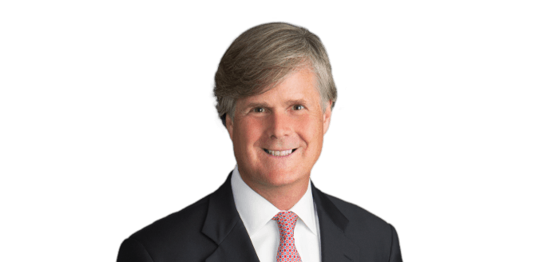
PRESENTERS
David H. Wilson
Hawkins Parnell & Young
Atlanta, Georgia dwilson@hpylaw.com
(404) 614-7412
Nicholas D. Brauns
Higgs Fletcher & Mack, LLP
Atlanta, Georgia braunsn@higgslaw.com
(619) 236-1551

Slide 4
WHY ON EARTH WOULD PLAINTIFF COME TO TRIAL AND NOT PUT UP EVIDENCE OF MEDICAL SPECIALS AT TRIAL??
Plaintiff’s have been using anchors at trial for years to improperly inflate damages
Now in smaller cases, they want to “unanchor” the verdict from the medical bills claiming they will undermine the impact of the injury on pain / suffering ...
… and “anchor” to something more substantial

Slide 5
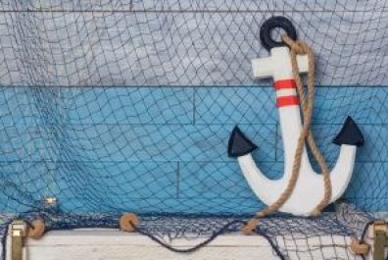
WHAT IS ‘THE ANCHORING EFFECT’?
Have to understand the “anchoring effect”
A cognitive bias that causes us to rely on a reference point, or “anchor,” when making future decisions or evaluations
Psychologists - “an effect where individuals’ numerical judgments are inordinately influenced by an arbitrary or irrelevant number”

Slide 6
WHAT IS ‘THE ANCHORING EFFECT’?
Well known sales technique –
$1,000 Purse
$300 Bottle of Wine
Top of the Line Automobile

Slide 7
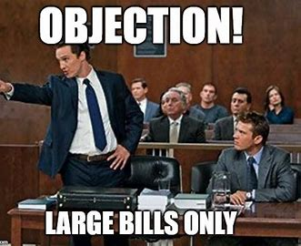
WELCOME TO OUR WORLD!
Plaintiff’s attorneys asking jurors to award ever higher awards for pain and suffering … and often getting it!
Research shows, “the more you ask for, the more you get”
The practice has greatest impact on non-economic damages / pain and suffering

Slide 8
WELCOME TO OUR WORLD!
Why Focus On Noneconomic Damages / Pain and Suffering ?
These awards are highly subjective and not easily quantified by $$$ amounts
“Anchor creates a psychologically powerful baseline for jurors struggling with a monetary value for pain and suffering …”
Trial = cognitive overload
An anchor is welcomed to reduce the cognitive effort to determine non-economic damages when worn out.
Allows jury to compromise and negotiate up or down … but key is that baseline is a big [arbitrary and irrelevant!] number

Slide 9
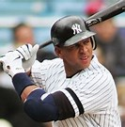
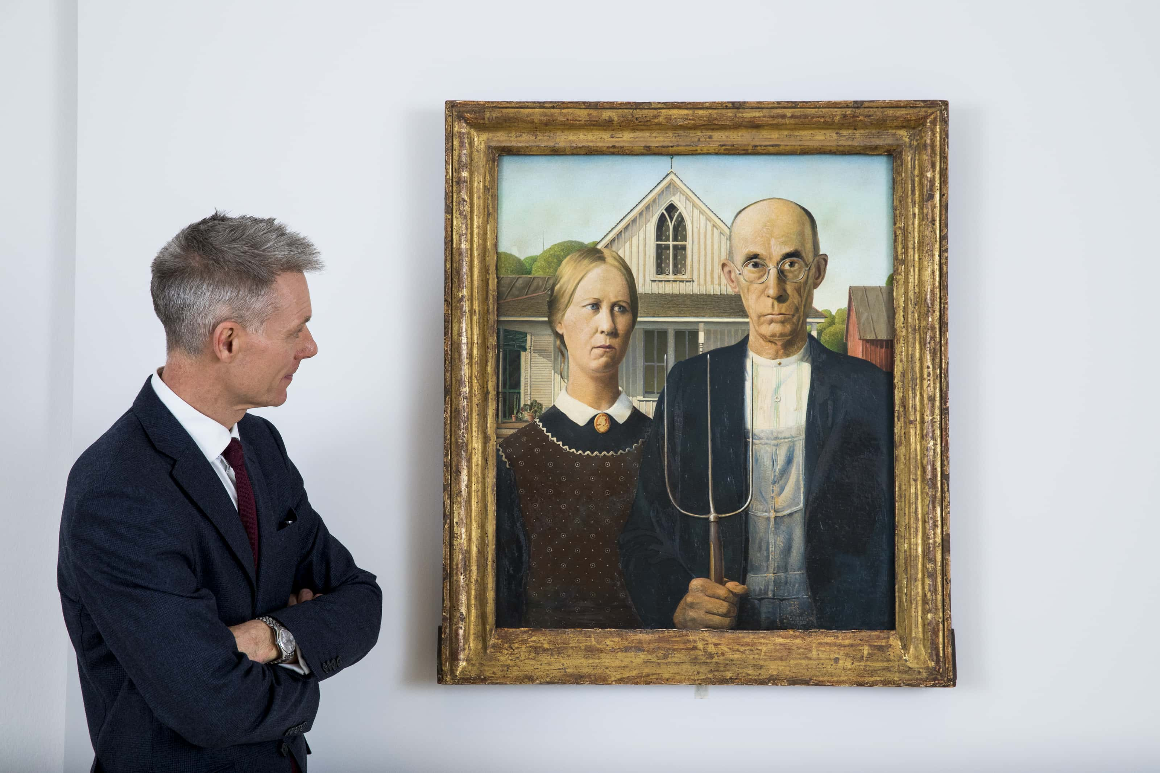
RECENT EXAMPLES OF TRIAL ANCHORS
Catastrophic Cases / Wrongful Death
Sports Salaries
– Ga $22 million [Pete Law]
CEO Compensation
– Ga $155 million [Jim Butler]
Priceless Art
- Texas – $16.5 million [Gregory v. Cohan]
“Can’t come back in 5 years …”

Slide 10
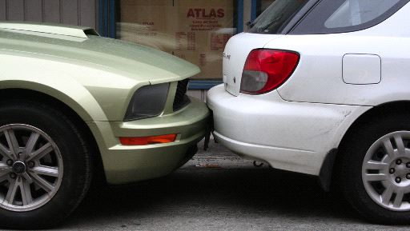
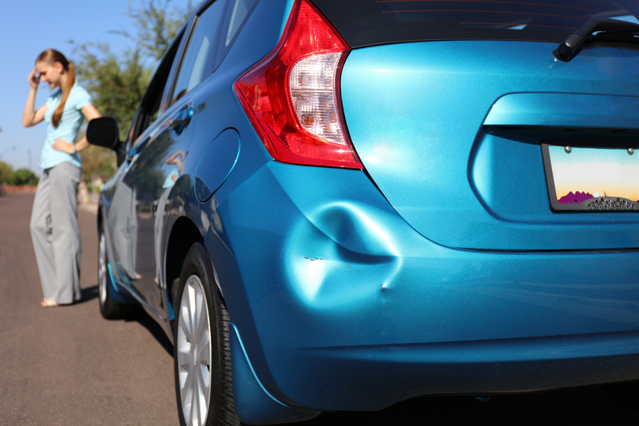
GROWING TREND – Exclude All Evidence of Economic Damages
What about smaller cases where special damages / medical bills are not that impressive?
Exclude all evidence of medical specials / economic damages
Anchor to something with more value … it works in bigger cases why not try it in smaller cases!
Focus only on pain / suffering – “Medical expenses bear no relation to amount of suffering …”
Happening especially in locations where evidence is based on what is paid v. what is billed

Slide 11
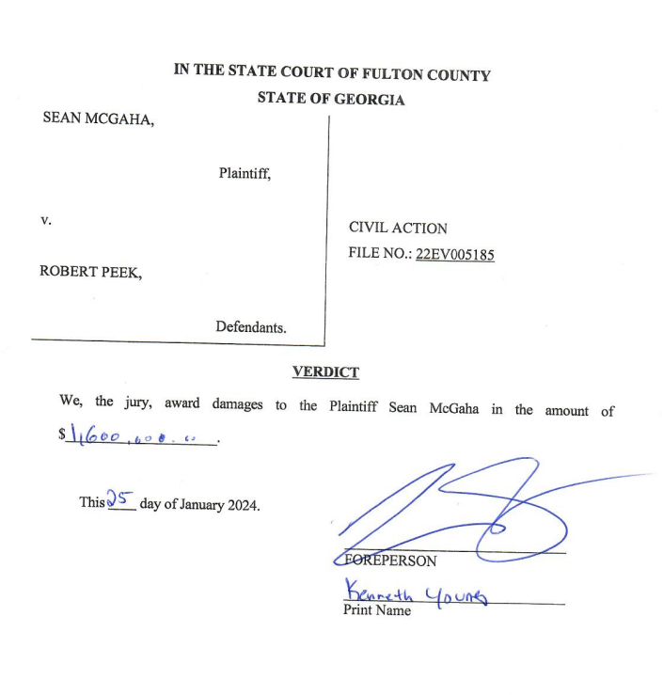
RECENT EXAMPLE - $1.6 million verdict
2024 Fulton County, GA
Disputed liability bicycle v. bicycle collision
Lower medical bills
“We did not want jury to feel tied to that number when determining pain and suffering …”
Verdict - $1.6 million [17X’s meds]
Anchors:
Had to give up something plaintiff loves [biking]
Treatment had good result but has lingering pain

Slide 12
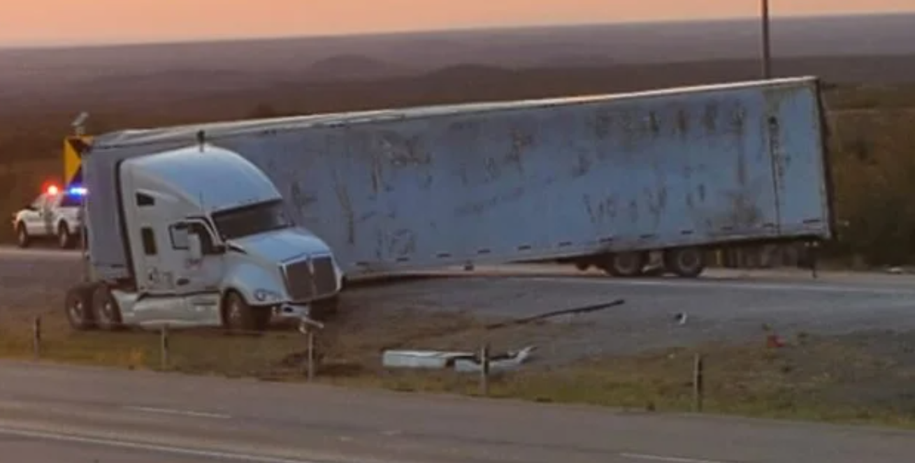
GOOD OPINION REGARDING IMPROPER ANCHORS
Gregory v. Cohan – 2023 Texas Supreme Court
Facts
18-wheeler jack-knifed – icy, dark highway
$16.5M verdict for one of the decedents – 90% non-economic damages
Big case but the Court’s reasoning as to improper anchors applies to smaller cases too …

Slide 13
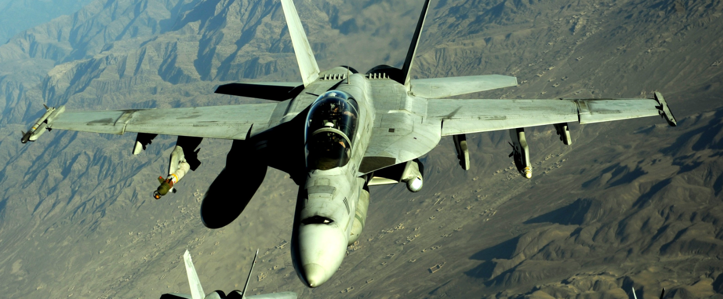
RECENT EXAMPLES OF TRIAL ANCHORS
In closing, counsel referenced a $71 million cost of F-18 fighter jet …

Slide 14
RECENT EXAMPLES OF TRIAL ANCHORS
… and a Rothko painting that sold for $186M

Slide 15
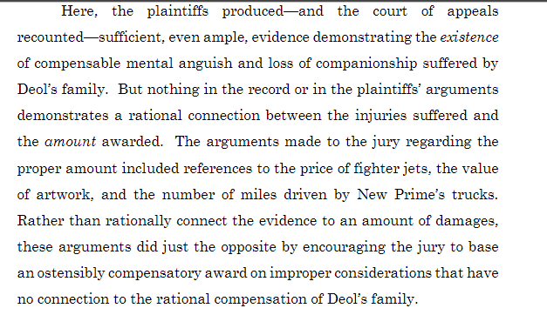
RECENT EXAMPLES OF TRIAL ANCHORS
Texas Supreme Court - Reversed

Slide 16
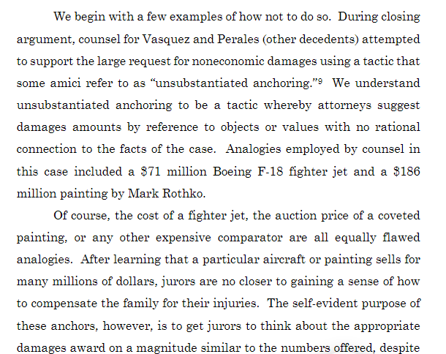
RECENT EXAMPLES OF TRIAL ANCHORS
Texas Supreme Court – Reversed
How to determine non-economic damages
Hard to do
This case example of how “not to do it”

Slide 17
RECENT EXAMPLES OF TRIAL ANCHORS
So, in smaller cases, may not get anchors like fighter jets, or priceless paintings, but may get:
Per diem arguments – in pain every day, give $___ for 8 hours a day, 5 days a week for life expectancy
Asking for a number or hourly rate for each component of pain and suffering
Can’t do something I love .. riding bike, playing with child, walking pets
Not seeking medicals or lost wages to focus on bigger anchors . . .

Slide 18
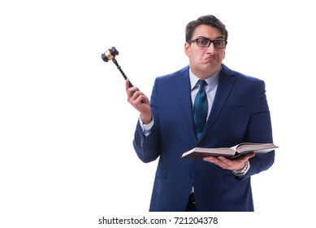
DEFENSE STRATEGIES
So now that we know what anchoring is and what plaintiffs are doing …
What can we do about it?

Slide 19
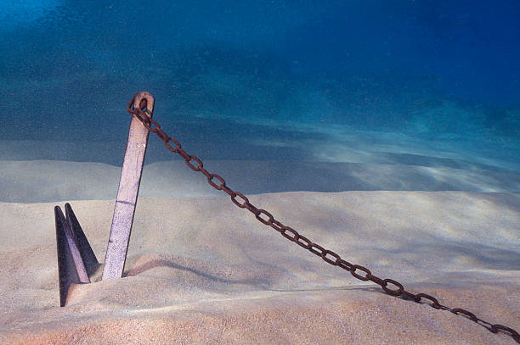
DEFENSE STRATEGIES FOR ANCHORING
Strategies before trial:
Motions in limine
Voir Dire

Slide 20
DEFENSE STRATEGIES FOR ANCHORING
Motions in Limine
1. Ask judge to exclude arguments based on
Different facts
Different people (e.g., celebrities, athletes)
Different injuries/damages
Non-sequiturs (e.g., lotto jackpots, CEO compensation, expensive things)
“Per diem” arguments
Same arguments in Texas case apply to smaller cases

Slide 21
DEFENSE STRATEGIES FOR ANCHORING
Motions in Limine
2. Ask judge to allow Defendants to put in evidence of medical expenses
[or challenge Plaintiffs motion to exclude such evidence when their recovery is not being sought]
Primary Argument -
Medical bills are relevant to determine the nature and extent of the claimed injuries and it should not matter who puts in the evidence.

Slide 22
DEFENSE CASES FOR USING MEDICAL BILLS
Nestler v. Fields, 824 S.E.2d 461 (SC App. 2021)
Jury awarded plaintiff $7,117 in damages – the amount of his medical bills.
Plaintiff did not put up medical bills – the Defense did
Plaintiff’s strategy was to focus on pain & suffering
Objected to defense introducing bills which “bore no relation to the magnitude of his damages” and were misleading to the jury and unfairly prejudicial
Appellate Court upheld trial court:
“We see no reason [the jury] should be kept ignorant of the cost of [plaintiff’s] medical treatment in determining the facts. What they did with that evidence was largely up to them . . .”

Slide 23
DEFENSE CASES FOR USING MEDICAL BILLS
Gladstone v West Bend Mutual, 166 N.E.2d 362 (Ind. App. 2021)
Jury award of $0.00 in damages.
Plaintiff moved to exclude evidence of medical bills on the basis he was not seeking recovery of medical expenses.
Defendant filed a motion in limine seeking to present the bills – granted by court
Appellate Court upheld trial court:
“We begin by rejecting [plaintiff’s] argument that evidence of medical bills is never relevant to the question of pain and suffering . Common sense and experience dictate that a more serious injury generally brings with it greater medical bills as well as pain and suffering.”
“. . .we decline [plaintiff’s] invitation to adopt a bright-line rule that evidence of medical bills is always inadmissible on relevance grounds when their recovery is not sought.”

Slide 24
DEFENSE CASES FOR USING MEDICAL BILLS
Barkley v. Wallace, 595 S.E.2d 271 (Va. 2004)
Plaintiff sought to introduce medical bills at civil trial - even though they had been discharged in bankruptcy – and claimed they were relevant for proving pain and suffering.
Trial Court agreed with defense that they were inadmissible under the circumstances.
Virginia Supreme Court reversed, finding:
“. . . the medical bills before us were relevant because they tended to establish the probability of [plaintiff’s] claims that she experienced pain and suffering as a result of he accident.”
Same Argument Should Apply to Defendants Use of the Medical Bills
Not fair to only be admissible by plaintiffs to support the extent of the claimed pain and suffering.

Slide 25
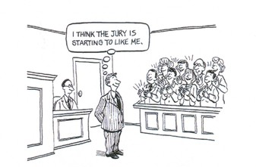
DEFENSE STRATEGIES FOR ANCHORING
Voir Dire Questions
Test jurors’ willingness to listen to evidence
Pre-try your case as much as judge/venue will allow
Emphasize jurors’ duty to
Follow the law
Consider the facts of this case

Slide 26
DEFENSE STRATEGIES FOR ANCHORING
Strategies During Trial
“Reverse Reptile” techniques
Timely objections
Attacking support for plaintiff’s anchor
Counter-Anchoring

Slide 27
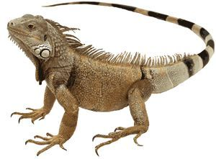
DEFENSE STRATEGIES FOR ANCHORING
Reverse “Reptile” Techniques
Goes hand-in-hand with countering verdict anchoring
Humanize and create empathy for your client
Emphasize fairness for all parties
Make your client your biggest asset at trial

Slide 28
DEFENSE STRATEGIES FOR ANCHORING
OBJECT!
During voir dire
During opening statement
During closing argument
Be courteous and succinct—but be clear
Contemporaneous objection may be required to preserve issue for appeal

Slide 29
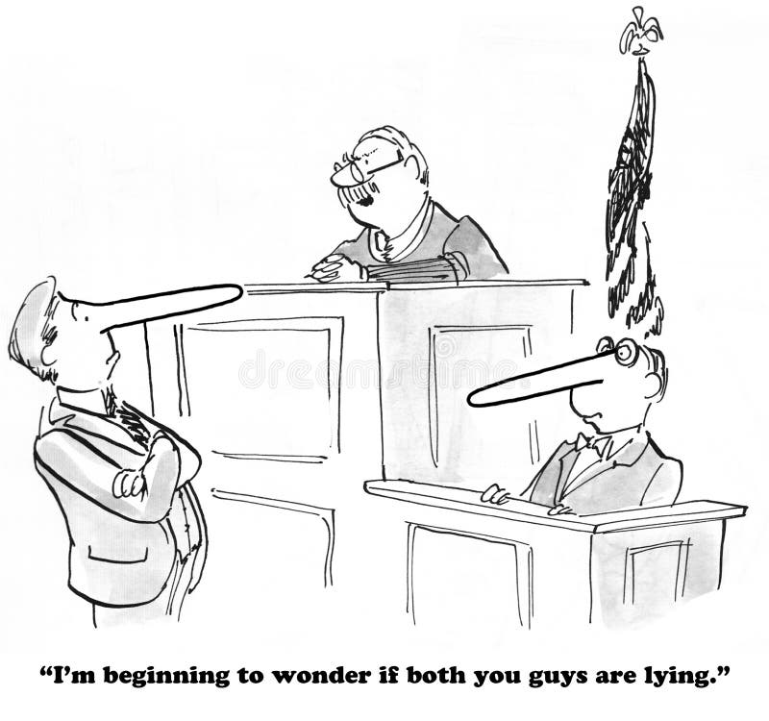
DEFENSE STRATEGIES FOR ANCHORING
Attack/Erode Plaintiff’s Anchor
Fairness/reasonableness—continue your theme
Just say it!
“That’s just a number he made up!”
“What does LeBron’s salary have to do with anything?”
“Mrs. Plaintiff was never going to be a brain surgeon . . .”
Explain concept of anchoring to the jury
Set this all up by showing jury you are the reasonable one

Slide 30
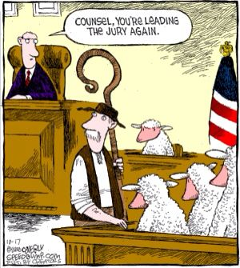
DEFENSE STRATEGIES FOR ANCHORING
Counter-Anchoring
Give jurors another choice or counterpoint for their discussions
You can do this even if you dispute fault or liability
You are simply providing information
Tie anchor to facts/figures in your case – ex., medicals, job history/salary
-“Why didn’t you hear anything about medical expenses?””

Slide 31
DEFENSE STRATEGIES FOR ANCHORING
Post Trial
Renew objections
Make the Court rule on objections
Preserve issues for appeal

Slide 32
Thank You! If you have any questions, please contact the presenters

