Slide 2
Is It A Turning Of The Tides Or A High Watermark?
Legislative Changes And Lobbying In Transportation

Slide 3
2023 STATE REFORM ACTIVITY
Seat Belt Nonuse Admissibility | Phantom Damages | 3rd Party Litigation Financing | Direct Action (Admitted Vicarious Liability) | Damage Caps | Failure to Equip | Joint and Several Liability/Allocatio n of Fault | Shortening Statutes of Limitations
CT, GA, IN, NE, WI | AR, FL, KY, MO, WV | CA, CO, IN, KY, LA, MO, MT, NV, NJ | IN, LA | IA | FL, TX | SC, VA | FL, MO
Notes:
CA, CO, and KY legislators have introduced bills regulating 3rd party litigation funders, but unfortunately, those bills do not include provisions requiring disclosure of those funding agreements in civil litigation. Hence, the proposed bills are identified in red in this chart. Their efforts are mixed since it is generally positive to regulate the industry, but it would be better if the funding agreements were discoverable too. CO’s bill (HB 23-1162) was signed into law by Gov. Polis on May 30th.
In Virginia, one of the few remaining states with pure contributory fault, legislators introduced a bill that would adopt a modified comparative fault standard (51% bar). The proposed Bill was tabled in the Courts of Justice Subcommittee. This proposed bill is identified in red in this chart since there is debate as to whether modified comparative fault is preferrable. I am sure we all have pros and cons for both standards based on our claims handling experience, and how states draft pattern jury instructions probably play into our respective lists of pros and cons.

Slide 4
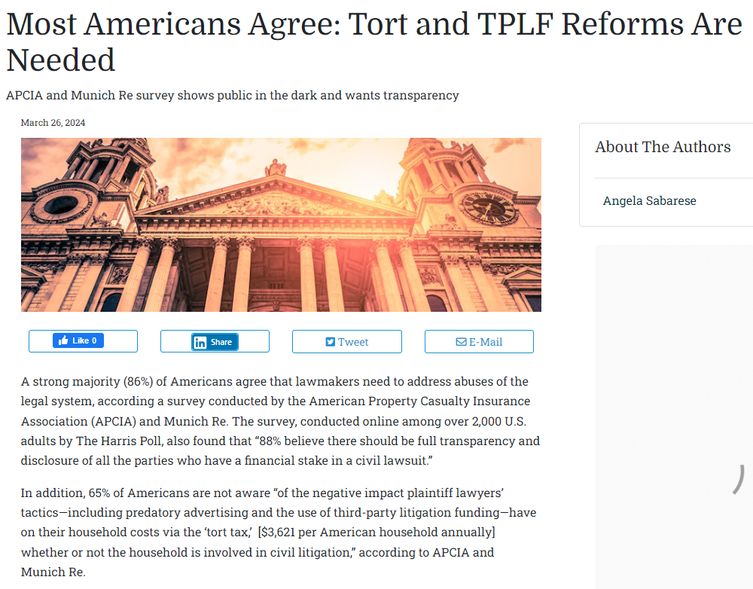
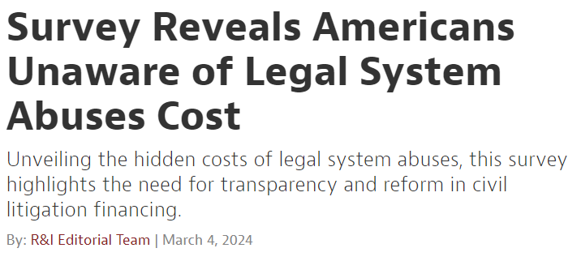
Is Public Opinion Always Against Us?

Slide 5
State Level Review – 2023 WINS*
Florida
HB 837: Legislation
that shortens the
statute of limitations,
alters the comparative
fault system to a
modified comparative
negligence system,
and allows evidence
of medical amounts
paid, not the gross
amount billed for medicals
Iowa
SF 228: Legislation that caps noneconomic damages and limits direct negligence claims (e.g., negligent hiring) against the motor carrier when vicarious liability for driver’s negligence is admitted
Indiana
HB 1124: Legislation that requires disclosure of civil proceeding advance payment transactions
Montana
SB 269: Legislation that requires disclosure of litigation financing agreements
Texas
HB 4218 (failure to equip reform) – Pending before Gov. Abbott
Louisiana SB 196 (3rd party litigation financing disclosure reform) – Vetoed by Gov. Edwards on 6/15/2023
Notes:
Florida – HB 837 signed into law on March 24, 2023
Iowa – SF 228 signed into law on May 12, 2023
Indiana – HB 1124 (3rd party litigation financing regulation and disclosure) signed into law on April 20, 2023
Montana – SB 269 (3rd party litigation financing regulation and disclosure) signed into law on May 2, 2023
Texas – HB 4218 (failure to equip) passed legislature and is pending before Gov. Abbott
Louisiana – SB 196 ((3rd party litigation financing regulation and disclosure) passed the legislature on June 4, 202. Unfortunately, Gov. Edwards vetoed the SB 196 on June 15th. But proponents do plan on reintroducing the Bill. So, maybe, technically, this isn’t a full win, but it is worthy of an asterisk (*) in the record books!

Slide 6
State Level Review – 2024 WINS (as of 4/24/2024)
ENACTED HB 1090 (evidence that the plaintiff is not wearing a seat belt may be admitted as proof of failure to mitigate damages, provided the plaintiff was 15 or older) and HB 1160 (amends existing state law to further reform third party litigation financing abuses and regulate the industry)
PASSED SB 426 (repealing the direct action statute unless the motor carrier is insolvent or bankrupt or personal service cannot be perfected on driver or motor carrier) and HB 1114 (referred to as the Data Analysis for Tort Reform Act (it will require insurance companies to disclosure certain data around the number of lawsuits filed, the total attorney fees and costs paid, and the total value of the incurred claims)) Gov. Kemp’s signed HB 1114 into law on 4/22/2024, while SB 426 remains on his desk, which he has until May 13, 2024 to sign.
ENACTED SB 583 (in tort litigation involving CMVs, noneconomic damages would be capped at $5M provided that the trucking company have at least $3M in aggregate commercial auto for each occurrence)
PASSED SB 613 (in tort litigation involving CMVs, noneconomic damages would be capped at $1M, provided that the driver was acting in course and scope of the trucking company) VETOED by Gov. Evers 3/29/2024.
ENACTED SB 850 (amends existing state law to further reform third party litigation financing abuses)

Slide 7
2024 State Reform Activity (as of 4/24/2024)
Seat Belt Nonuse Admissibility | Phantom Damages | 3rd Party Litigation Financing | Precluding Direct Action (Admitted Vicarious Liability) | Damage Caps | Joint and Several Liability/Allo cation of Fault | Shortening Statute of Limitations | Failure to Equip | Jury Anchoring
AL, GA, IN, NE, SD, WV, WI | AL, CT, LA, MO, WV | AL, AZ, CA, FL,GA, IL, IN, IA, KS, KY, LA, MO, NY, RI, WV, WI | AL, WV | AL, LA, WV, WI | SC | MO | FL | IN, MO, OK
Notes:
CA – does not require disclosure
KY – furthering the industry in KY and does not require disclosure
NV – ballot initiative around capping contingent fees
IN and WV – already had disclosure of 3PLF agreements statutes on the books – 2024 proposals expanded upon the prior good law
Other reform activity of noteworthiness: GA and LA (direct action repeal)

Slide 8
2024 State DEFORM Activity (as of 4/24/2024)
Repealing Damage Caps | Expanding Wrongful Death Laws | Lengthening Statute of Limitations | Allocation of Fault
CO*, KS, MD | MA, MN, NH, NJ, NY, VA | KS, LA | FL*, MN
Notes:
CO – ballot initiative
FL – proposed jury instruction (sunshine jury instruction)

Slide 9
State Level Review – 2024 DEFORM Activity (as of 4/24 /24)
Florida Proposed Amendment to Standard Jury Instructions – in response to HB 837, the Florida Supreme Court’s Committee on Standard Jury Instructions has proposed new language to reflect modified comparative fault (51% bar – Florida was previously a pure comparative fault state). “If you have assigned 50% or less of any negligence to [Plaintiff] you should award [Plaintiff]….”
Minnesota is seeking to modify its contributory fault calculations and allocations. As introduced, the bill allows a plaintiff to recover the entire amount of a benefit, including that paid by an employer and allows recovery of damages so long as plaintiff’s fault is not
greater than the aggregate of all defendants
(defendants would also be liable for the full award to the plaintiff if they are found 50% or more at fault).
Florida
Minnesota
Colorado Ballot Initiative 150 effectively aims to repeal noneconomic damage caps. The proposed change would allow a plaintiff to recover the total amount of monetary damages awarded by a jury or judge in a lawsuit involving catastrophic injury or wrongful death, eliminating the statutory caps on economic, non-economic, and punitive
Colorado
monetary damages. Similar initiatives in Kansas and Maryland.

Slide 10
Federal Lawsuit Abuse Legislation
Federal Lawsuit Abuse Legislation
Highway Accident Fairness Act of 2023 reintroduced in the 118th Congress – referred to the House Committee on 4/27/23
Proposes penalties to persons who intentionally cause (“stage”) a collision with a commercial motor vehicle and requirement for plaintiffs to disclose third-party litigation funding, including any funding agreements, 10 days after execution.

Slide 11
WHAT IS THE REFORM PLAYBOOK?
LESSONS LEARNED FROM FLORIDA AND IOWA
Assemble a good team: seasoned lobbyists, smart public relations campaign strategists, fundraisers, and subject matter experts
Assemble representatives from trucking companies who can explain the impact of lawsuit abuse (legislators want to hear from their constituents)
Rehearse testimony so that you are prepared, organized, and concise
Assemble hard data and concrete examples of the problems with the existing law
Assemble a coalition with aligned business interest groups who can support
Be prepared to start broad because the amendment and negotiation process will narrow the issues
Find a good bill sponsor and take time to educate other legislators and their staff
Have a regular cadence of communication and coordination once the legislative session starts
Be prepared for the long game!

Slide 12
Devil of the Details
Beyond Statutory Changes
Jury Instructions critical to effectuating statutory changes
Is modified comparative really better than pure comparative?
Are judicial elections the key? Judges application/control of procedure
Do we need to pursue tort reform in all states?
What can/should be done on the state level by front line attorneys?
An aggressive defense – on the front lines

