Slide 2
Counsel’s Conundrum: Cracking the Code of Client Expectations

Slide 3
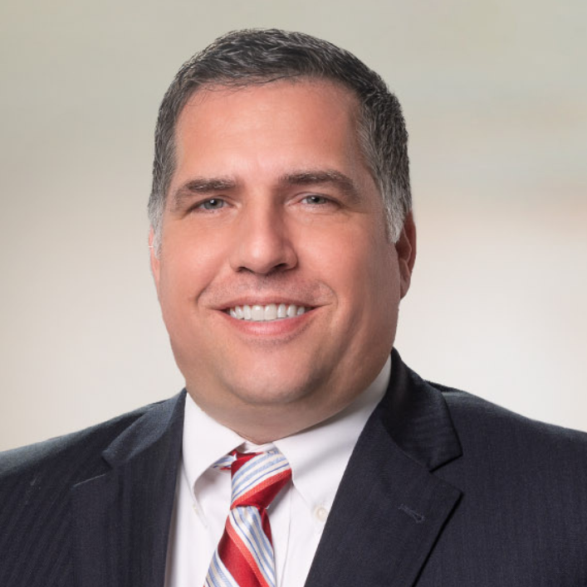
Presenters
Chris Keim
Managing Partner
Frantz Ward LLP
ckeim@frantzward.com
(216) 515-1629
Jordan Mayfield
Partner
Naman Howell Smith & Lee, PLLC
Mayfield@namanhowell.com
(254) 755-4207

Slide 4
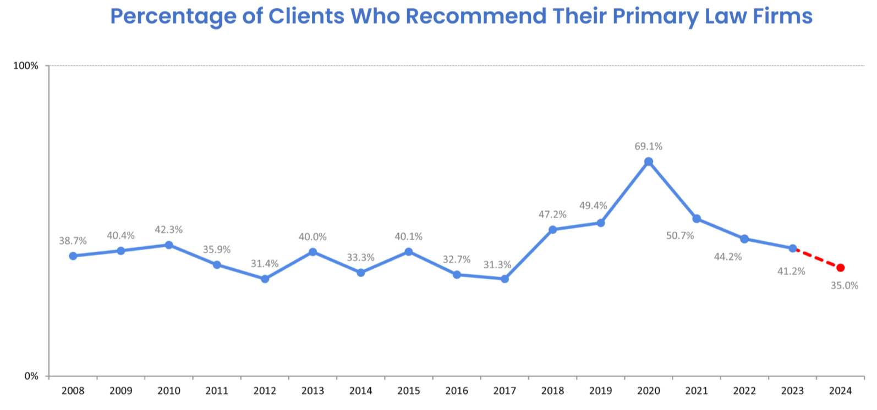
BTI Consulting Group 2024 Survey

Slide 5
BTI Consulting Group 2024 Survey
These new expectations include:
Including clients early in strategy and approach
Being trusted enough to be relied on for cost control
Higher client service standards for their primary law firms
Being easy to work with
Fielding the absolute best team

Slide 6
Association of Corporate Counsel 2024 Survey
52% Ordered to Cut Costs
59% Their workload increased
58% Overseeing 3+ business functions
27% Overseeing 5+ business functions
25% Plan to cut number of law firms
79% #1 reason to cut firms: cost-effectiveness

Slide 8
Communication = Key
Learn internal structure
Communication preference
Responsiveness
Key information

Slide 10
In-House Client Priorities
(Polling Question – Pick One)
Leading factor in law firm evaluation:
Pricing/Value
Trust
Know my industry
Staffing/DEI
Communication

Slide 11
Outside Counsel Frustration
(Polling Question – Pick One)
Biggest impediment to successful relationship:
Lack of trust from client
Inside client too involved
Inside client not involved enough
Rates
E-Billing

Slide 12
ALFA LAWYERS FRUSTRATION SURVEY
E-Billing: Third-party reviewers don’t understand case
Frustration with Plaintiff’s bar being taken out on defense counsel:
“Stupid case” – get it done now/cheap/don’t spend money
Discovery obstacles:
Response time
Prohibited from talking to internal client

Slide 13
ALFA LAWYERS FRUSTRATION SURVEY
Settlement authority: Delay due to decision-maker (busy vacation)
Best practices:
Provide checklist regarding what being sent over in claim file/client documents
Driver contact information should be page one

Slide 14
Staffing/DEI
Internal pressures/goals on DEI
Dedicated partners/associates to the client

Slide 15
Rates
Hourly rates
Rate increases

Slide 17
Litigation Plan
Early Assessment
Budget

Slide 18
Outside Counsel Plan

Slide 19
Client Surveys/Feedback
(Polling Question – Outside Counsel only)
Do you regularly conduct client service
surveys/replies/feedback
Yes or No

Slide 20
Client Surveys/Feedback
(Polling Question – In-House Clients Only)
Do you like when outside counsel conducts
surveys/replies/feedback
Yes or No

Slide 21
Wrap Up
Key Takeaway

